Slide 1
Design Pattern
Huanmin Wu

Slide 2

Step by Step
Step 1: Requirements clarifications
Step 2: System interface definition
Step 3: Scale estimation
Step 4: Defining data model
Step 5: High-level design
Step 6: Detailed design
Step 7: Identifying and resolving bottlenecks

Slide 3
Key Characteristics of Distributed Systems
Scalability
Reliability
Availability
Efficiency
Manageability

Slide 4

API
Request queue
Web UI
datastore
App
Services
Backend
Common Architecture

Slide 7
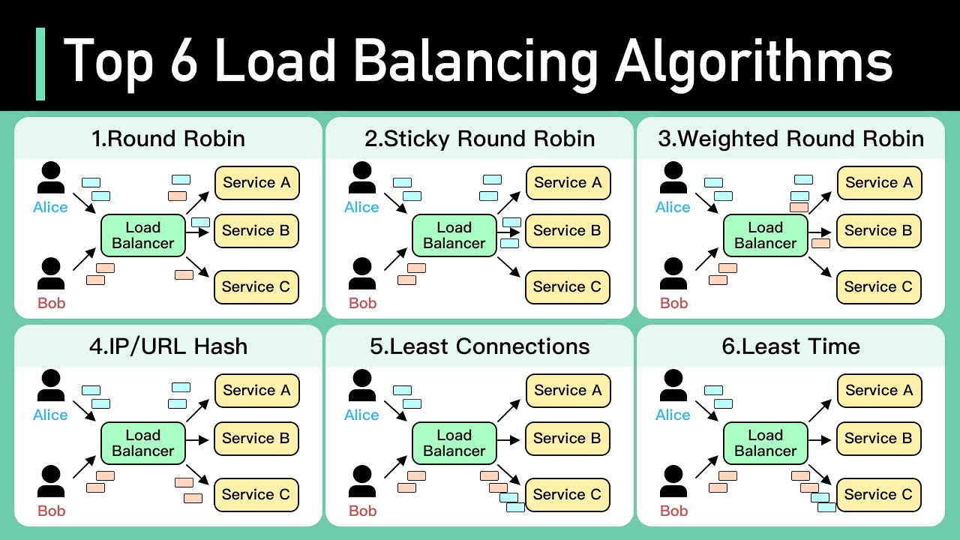

Slide 8
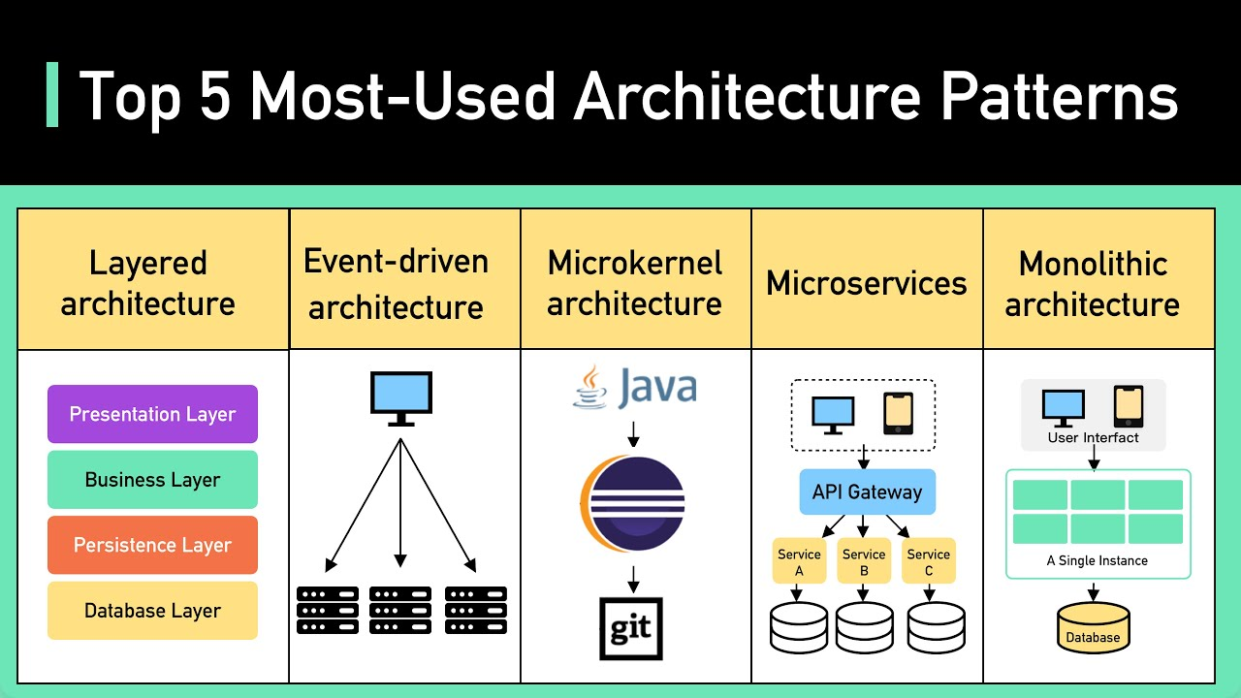

Slide 9
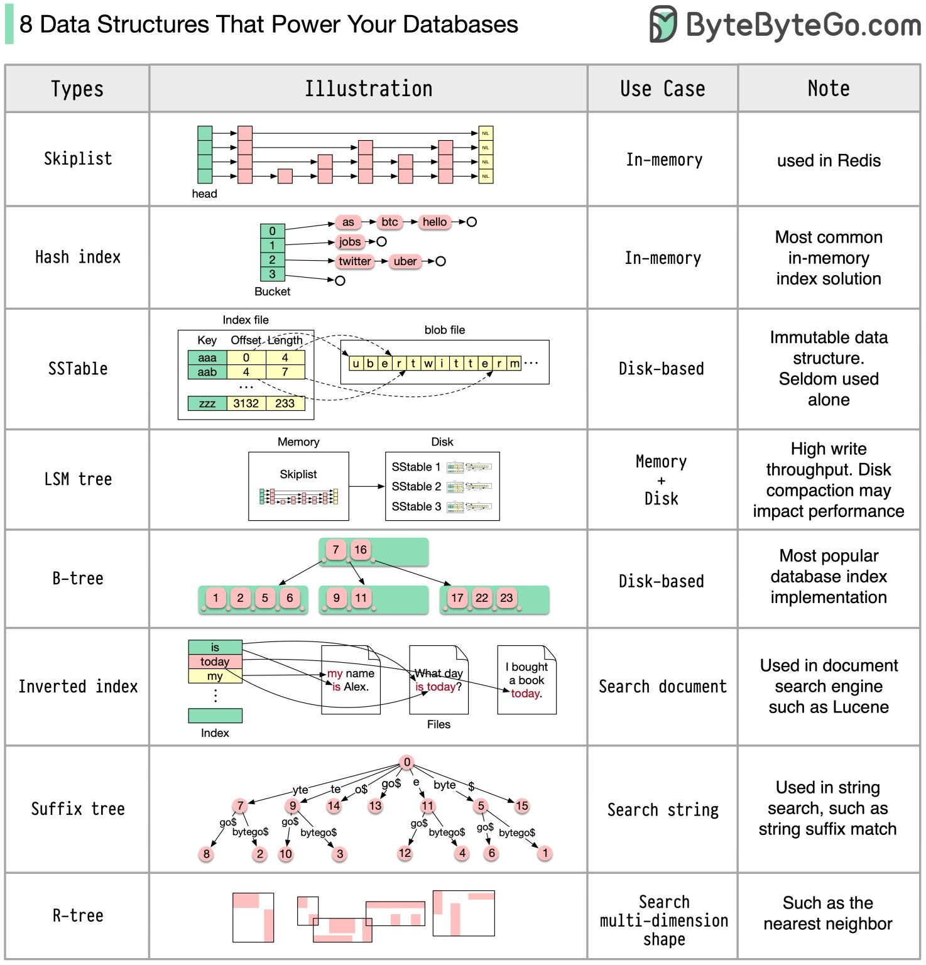

Slide 10
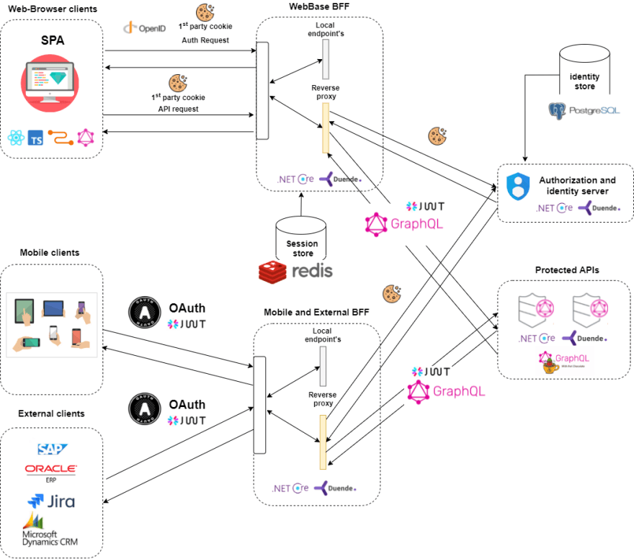

Slide 11
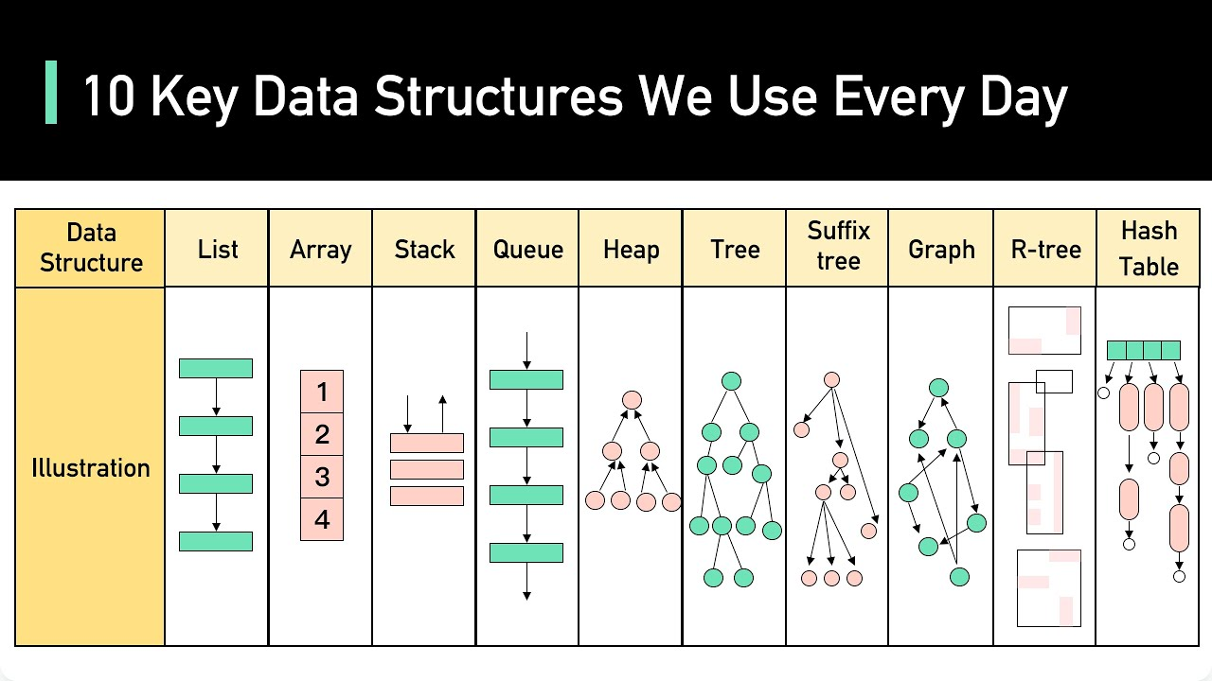

Slide 12
Scalability
API load balance
Stateful or stateless
Auto expand and shrink
Partition Data
What is the partition key?
What if you have hotspot?
Elastic query and aggregation.
Centralized or distributed catalog
Consistent Hash

Slide 13
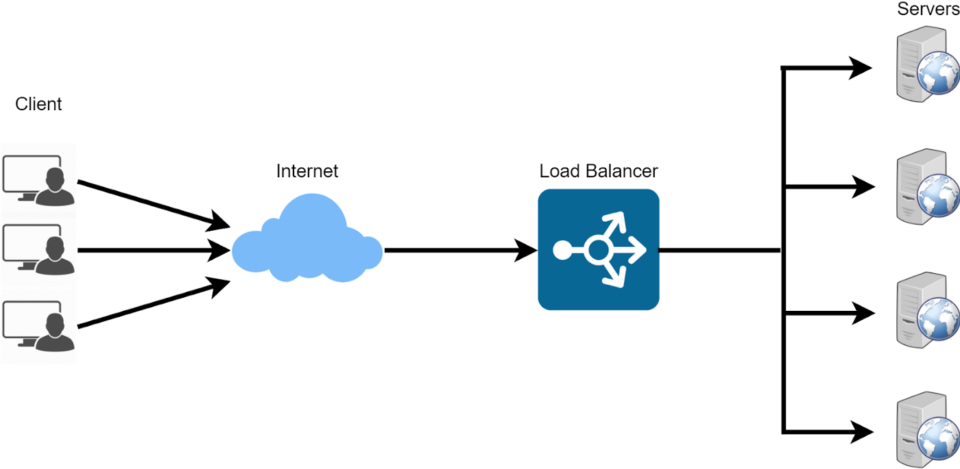
Load Balance
Benefits of Load Balancing
Fail fast, less downtime
Less stressed component
High throughput and less latency
Algorithms
Least Connection
Round Robin
Least response time
Least bandwidth used.
Watch for stateful API

Slide 14
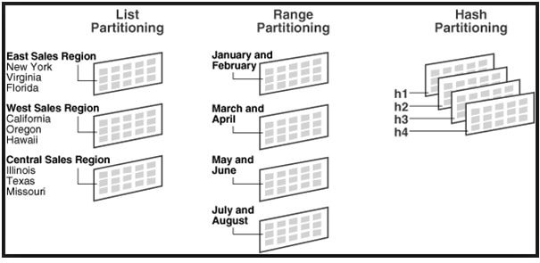
Data Partitioning
Partitioning Methods
Split Rows
Split Columns
Partition by directory
Partitioning Criteria
Key hash table
Range partition
Round-robin
Common issues with partition
Joins and Denormalization
Referential integrity
Rebalancing

Slide 15
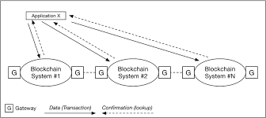
Reliability
Requirement
A transaction can be complicated with many steps. It should either complete or fail, no unknown state.
Timeout is common, retry should not cause duplicate
Solution
Idempotency
State machine
Write ahead log

Slide 16
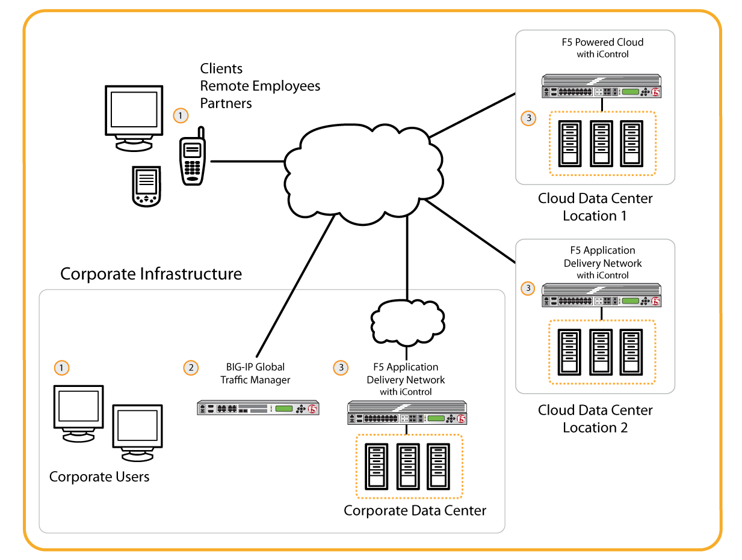
Availability
Requirement
Service should be available even part of the system is down
API availability and data availability
Solution
Redundancy
Replication
CAP Theorem

Slide 17
Client Server connection
HTTP request and REST API
Ajax Polling
HTTP Long Polling
Web Sockets

Slide 18
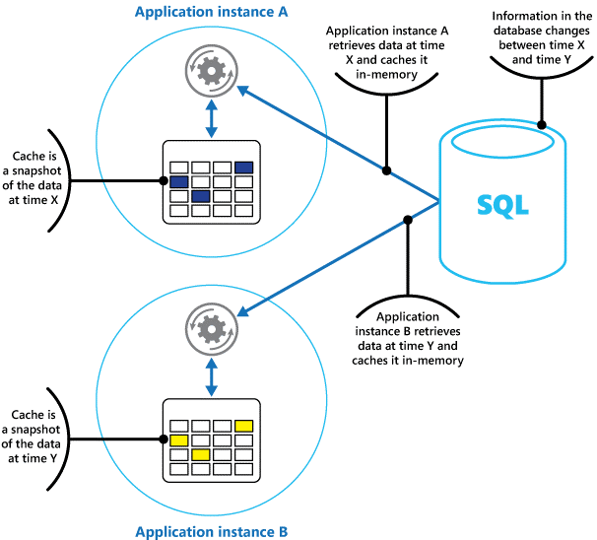
Cache
Cache type
Application Server cache
Content Distributed Network
Distributed cache and cache consistency
Cache invalidation
Write-through cache
Write-around cache
Write-back cache
Cache eviction policies
FIFO, LRU, LFU, Random

Slide 19
SQL vs No SQL
Scale
OLTP table limit as 300-500GB and 10 million rows.
Tera bytes will not accommodate RDBMS.
Data consistency
ACID lead to database
Data format
Complete table or sparse table
Query type
Relational ? Read only? Batch? Streaming?

Slide 20
Data Consistency
Complete data integrity
Consistency between data sources
Consistency in replicas
Deliver only once.
Monotonic Read Consistency

Slide 21
Operation
Logging, Monitoring and alerting
Authentication and Authorization
Deployment
Throttling and circuit break

